Slide 1

ProFinder

Slide 2

Is it a pleasure for you when you after difficult day have to think
what product and where you have to buy in order to make supper?
Definitely not.

Slide 3
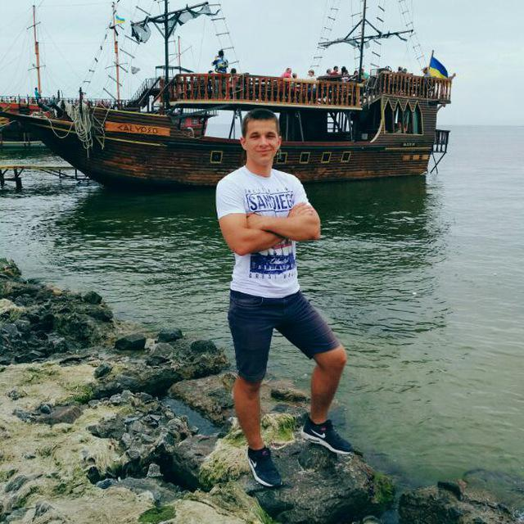


Pavlo Reva – software engineer and tester.
He developed components according to requirements and covered them with unit tests.
Denys Saukh – system architector.
He designed the structure of the system, came up with the relationship between the components.

Slide 4


Lesia Volobuieva - software engineer and tester.
She developed components according to requirements and covered them with unit tests.
Olha Bahno – business analyst.
She collected all the requirements, broke them down by tasks, she was an intermediary between the customer and the developers.

Slide 5

Analysis of the problem
We have chosen this project, because there are such actual problems:
High cost of food
Poor quality of food (or complete lack of quality).
How much audience can be interested in the product to become topical?
Firstly, people of all age categories, whose interest is the quality of the product.
Secondly, people of all age categories, whose interest is the value of the product.
And finally people of all age categories who buy food in supermarkets.
Why this product could be interesting for you?
There are several reasons:
The ability to quickly find out all the necessary information about the product
Reducing the amount of time spent on finding a quality and affordable product
Simplicity, ease, efficiency and availability of product use by a large number of users.

Slide 6

ProFinder is a conceptually new product on the food area in Ukraine. It really has no analogs in Ukraine and usage of this will like the step in future. And we try to provide the best reasons why you should review our product as one that worth working with.

Slide 7

Every day people face with problems of food with quality that does not match to its price. It is too hard to find really food, which will have good quality and corresponding price in the same time. Our product can solve the problem.

Slide 8




ProFinder consists of three modules: user part, market part and admin panel. User will be able to find what he really wants. In addition, he has opportunity to give feedback to some market and it will have influence for quality of the products. Market owner has to regulate prices and discount offers via ProFinder. Moreover, admin from admin panel can regulate relationships of buyer with a market. User will have never seen markets with bad goods and high prices. All types of the users will have benefit – usual users will have good-quality products for a corresponding price.

Slide 9



Description of the actors in the system
The buyer is the main actor of the system. It is for its use that this project is being developed. The buyer will be available all the functions of the application, which will improve and accelerate the process of buying the desired goods in the store.
The store is one of the main actors of the system, as the developed application assumes the creation by the buyer of the rating of stores. In addition, the store itself provides the necessary information about the goods in case of interest by this application.
The programmer is the creator of the application. It interacts with the application most often: both at design time, and as a potential user, and after the release of the project in order to improve it.

Slide 10
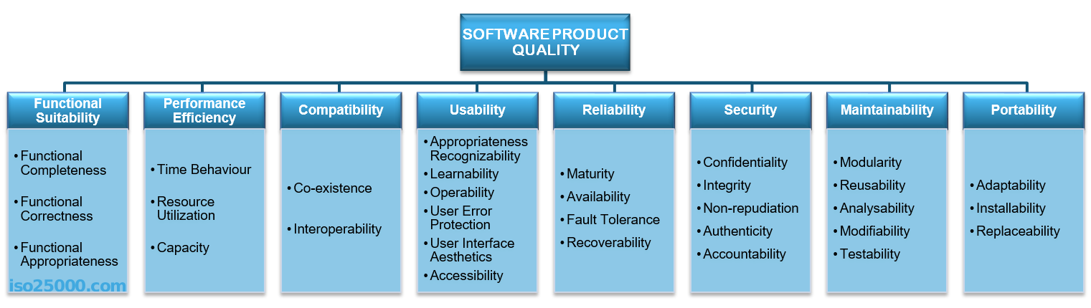
Quality attributes types
This standard describes the quality attributes for a software product. Next, we’ll look at what exactly each attribute means individually.

Slide 11
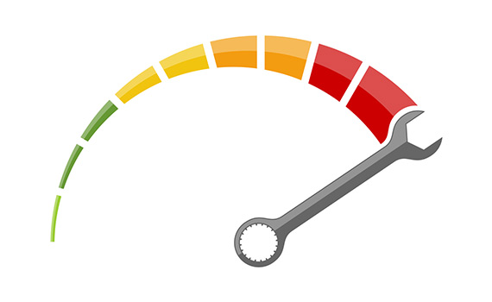

Performance shows the response of the system to performing certain actions for a certain period of time.
There are two ways how to measure performance:
Latency: Time spent on responding to an event
Channel capacity: The number of events that occur at a certain point in time.
In practice, the possible performance indicators include, for example:
Average/maximum number of system users per time unit.
Average page load time.
Average method execution time.
Performance issues very often grow into problems that can affect everything, from the server’s capacity or the ways in which you develop your front-end to the efficiency of database queries or the capacity of communication channels.

Slide 12

Usability is one of the most important attributes, because, unlike in cases with other attributes, users can see directly how well this attribute of the system is worked out. One of the key problems of usability is too much interaction or too many actions necessary to accomplish a task. Incorrect sequences of steps in multistage interfaces are also a problem of usability. Data elements and controls may be designed not according to the accepted patterns of user experience, which also complicates the interaction. For example, if you are developing an iOS application, then it is important to use the guidelines from Apple, or the guidelines from Microsoft — for Windows desktop applications.

Slide 13


Slide 14
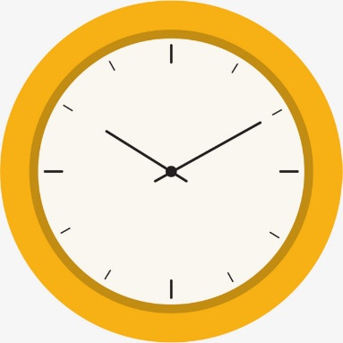


Availability is part of reliability and is expressed as the ratio of the available system time to the total working time. Important indicators for this attribute are:
Availability.
Planned downtime.
Time needed to update the software, and so on.

Slide 15


Slide 16

Supportability is the ability of the system to provide useful information for identifying and solving problems. The main problems in ensuring supportability can be addressed with the following means:
No diagnosis: How the activity and performance of the system are controlled. This includes various types of logging.
No tools for troubleshooting: This includes backups, various systems for creating snapshots of the system, and tools for auditing the system. When the system fails, it is always more pleasant to wait for an automatic restart than to solve the issue manually.
No health checking: This includes a variety of systems for measuring compilation time, deployment time, database size, or mobile application size.

Slide 17
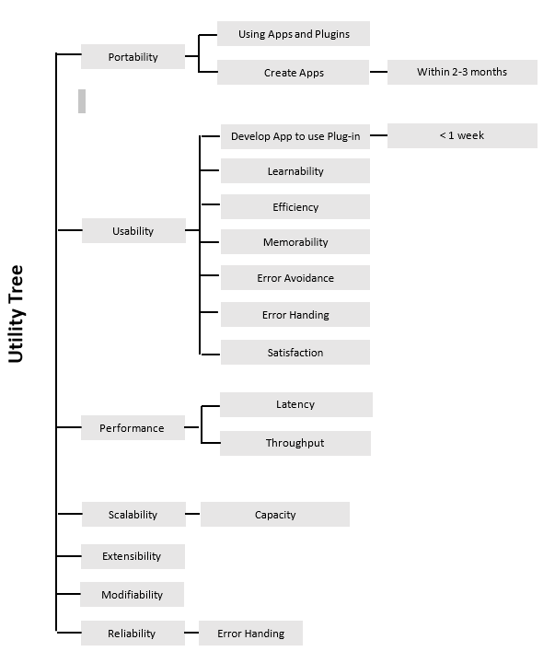
Utility trees are a way to organize these quality attributes. In regard to ATAM they serve as a way to prioritize quality attributes and later to evaluate the suitability of a candidate architecture vs. the requirements. I also like to use them as reference requirements and stories (or themes depending on size) as part of a backlog in agile development.

Slide 18
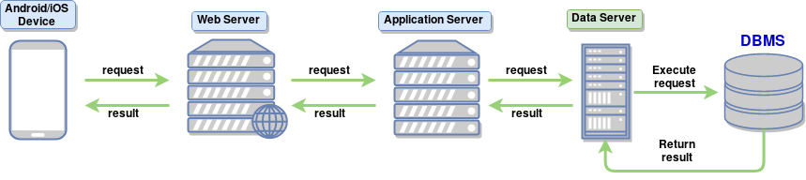
System Structuring

Slide 19
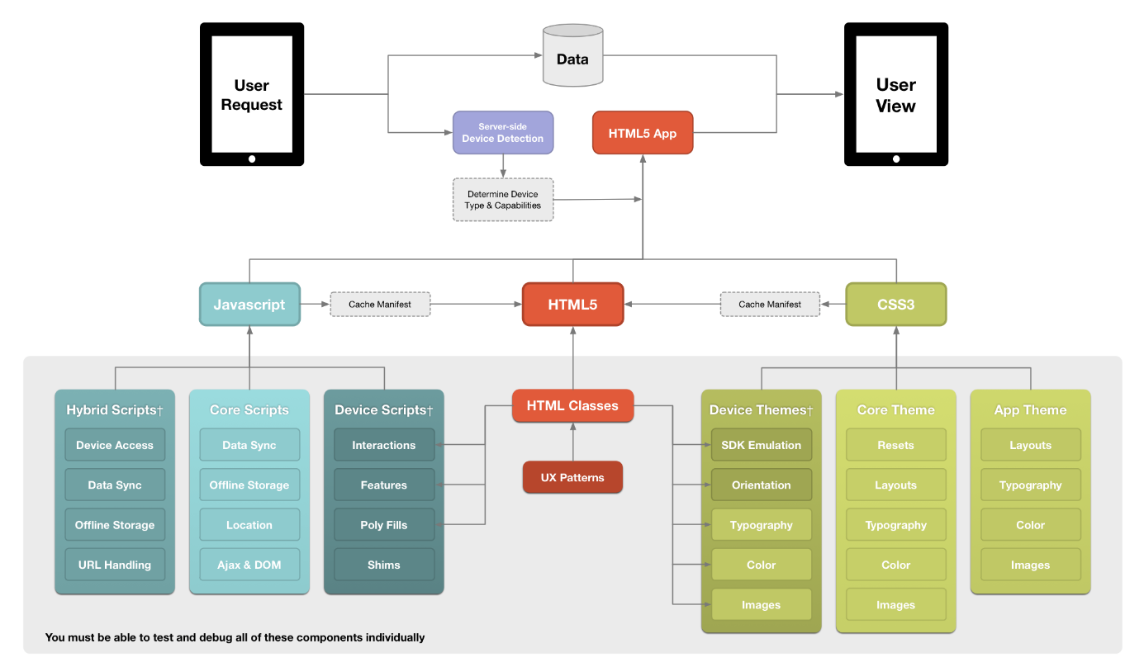

Slide 20
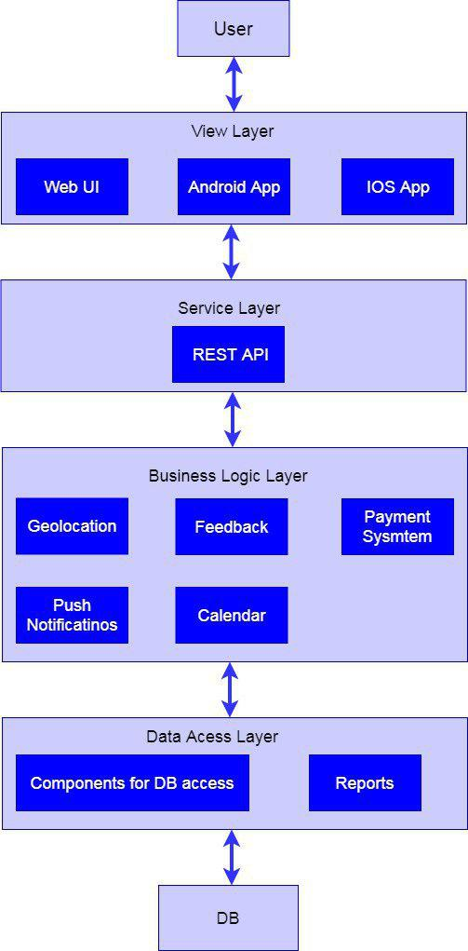
Layered Diagram
Layered Diagram

Slide 21



Vision Document
The purpose of creating this mobile application is the need for qualitative products and the solution of the problem of minimizing the time of searching for quality food products. The version of the software product at the time of writing the concept document is 1.0.1.
Main users of the system: • Stores products with good reputation and product quality. • A variety of plate-based buyers with a mobile device.

Slide 22
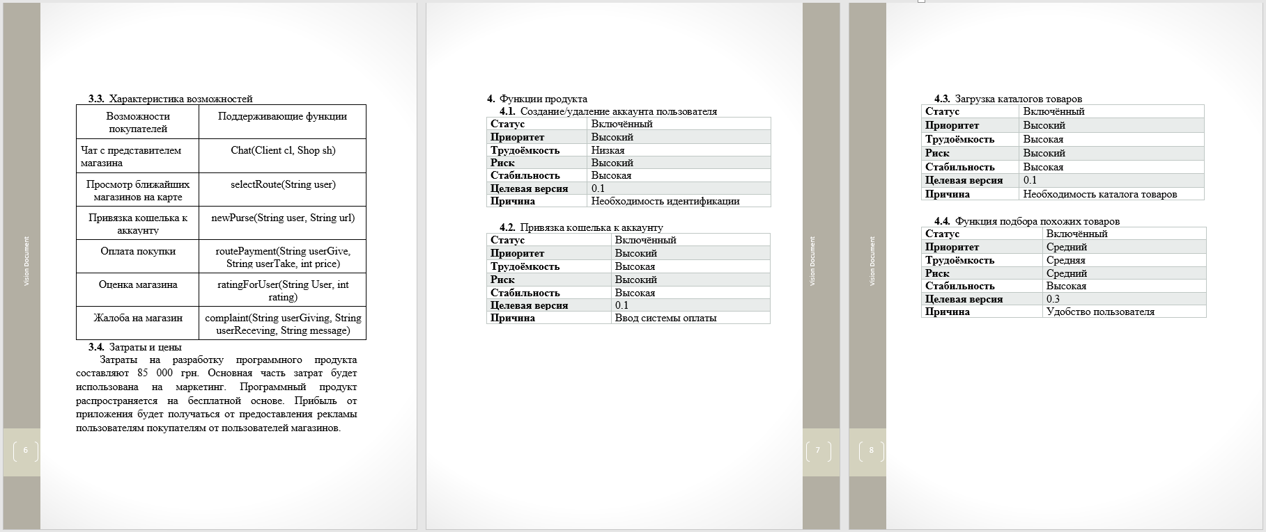
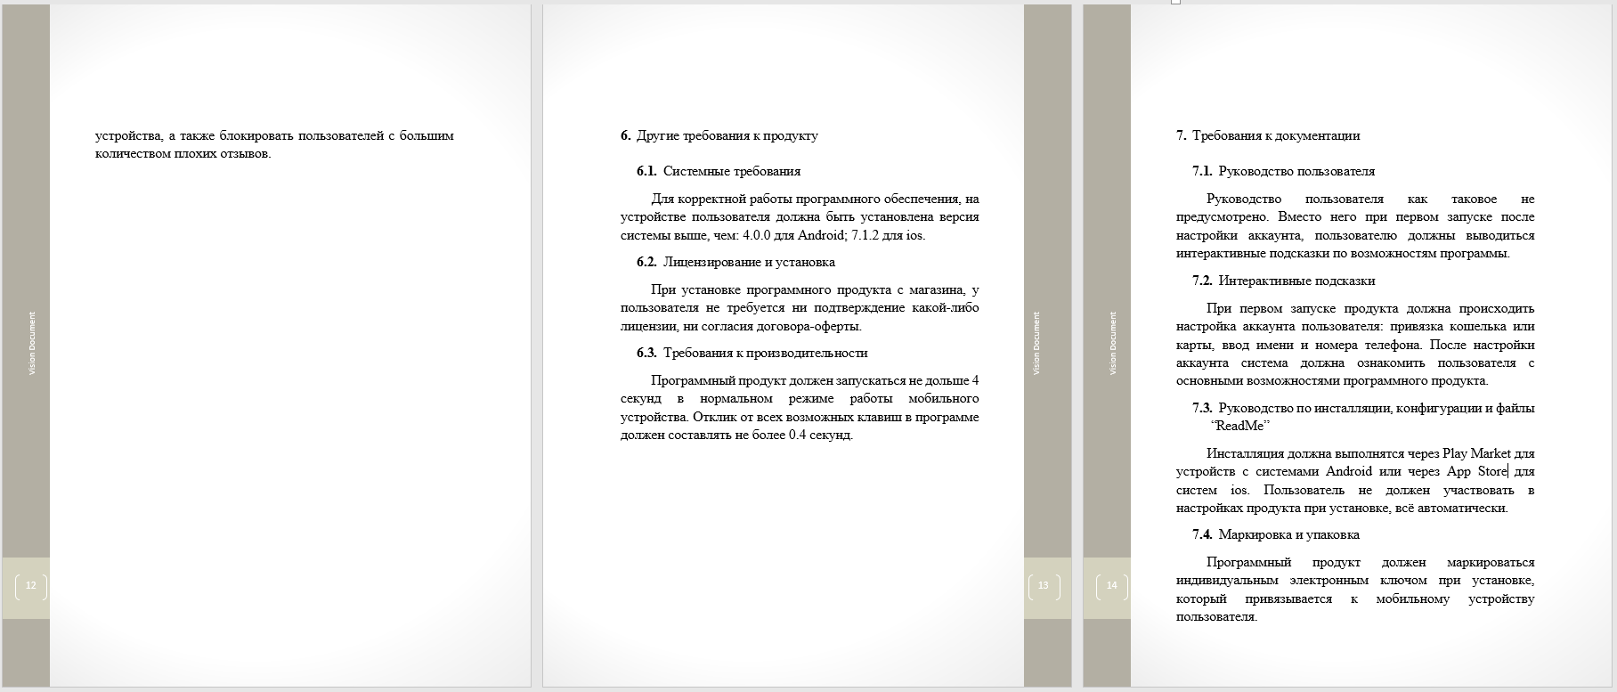

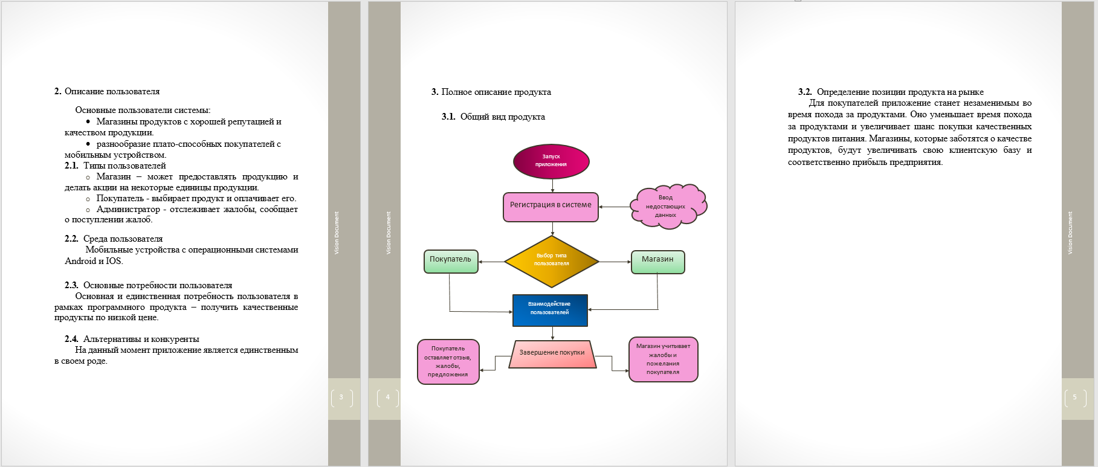
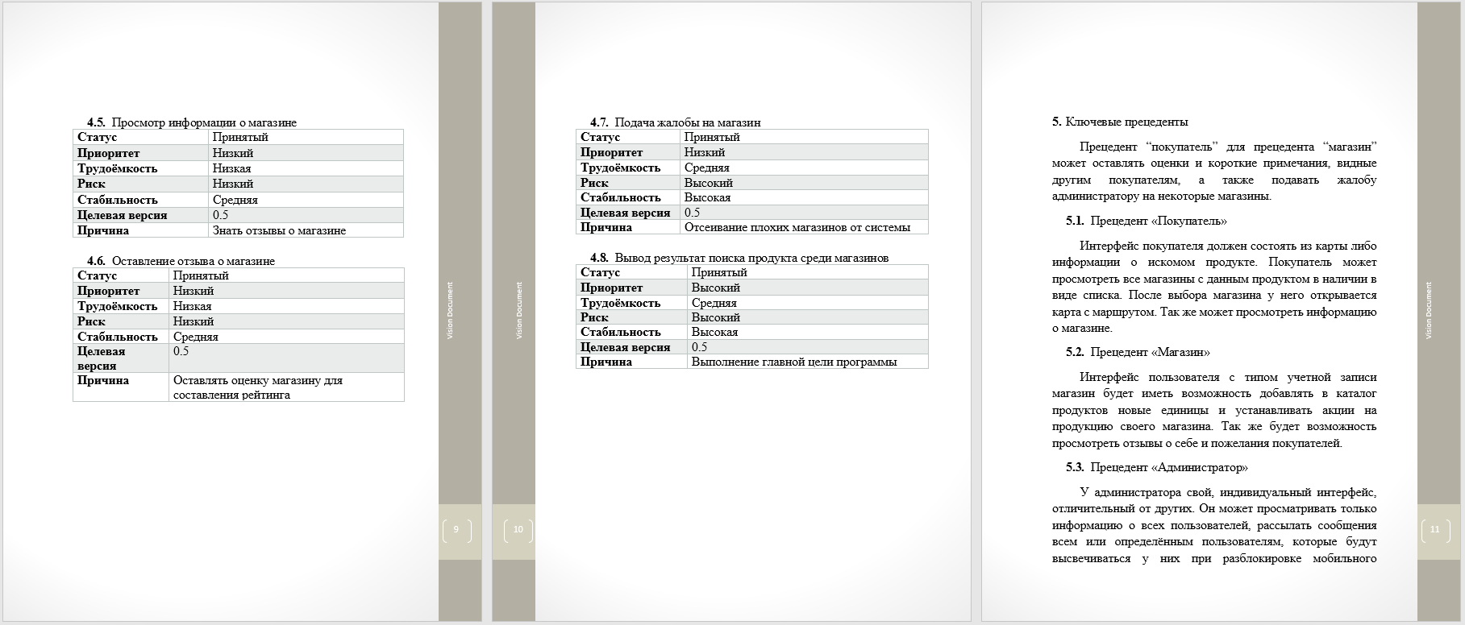
Vision Document

Slide 23



Document Delta Vision
This document includes changes in comparison with the previous version of both the concept document and the software product itself.
It was added features such as feedback from the store via chat, translation of messages inside the application for foreign buyers / shops, a map with the location of stores, adding a rating for the store. • The version of the software product at the time of writing the concept document is 1.1.0.

Slide 24

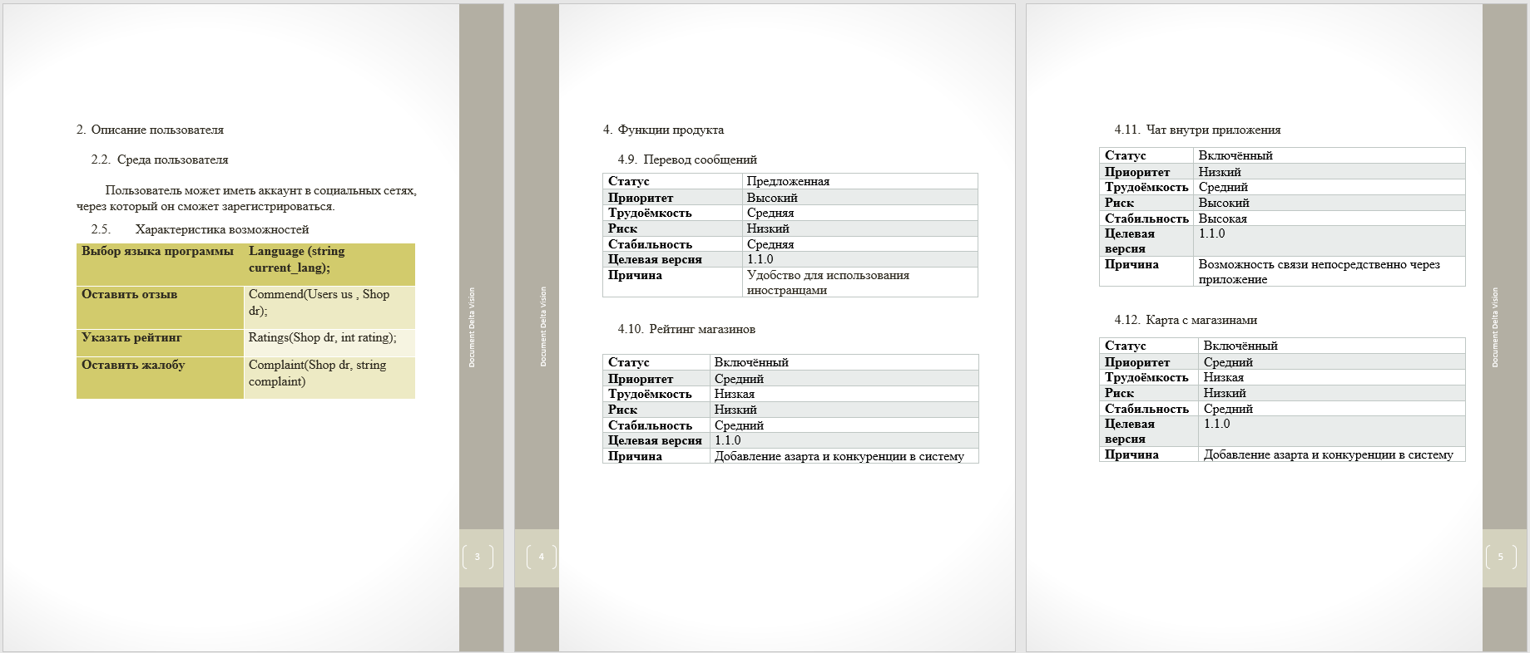
Document Delta Vision

Slide 25








Slide 26

ATAM
The Architecture Tradeoff Analysis Method (ATAM) is a method for evaluating software architectures relative to quality attribute goals. ATAM evaluations expose architectural risks that potentially inhibit the achievement of an organization's business goals. The ATAM gets its name because it not only reveals how well an architecture satisfies particular quality goals, but it also provides insight into how those quality goals interact with each other—how they trade off against each other.

Slide 27

Outputs of ATAM
A set of architectural approaches
A set of questions about the quality attributes
A Utility Tree
The risks identified
A set of scenarios

Slide 28
Prototype

Slide 29
Friendly design could help you to not only enjoy and get a pleasure, but also to feel comfortable during working with our application.

Slide 30
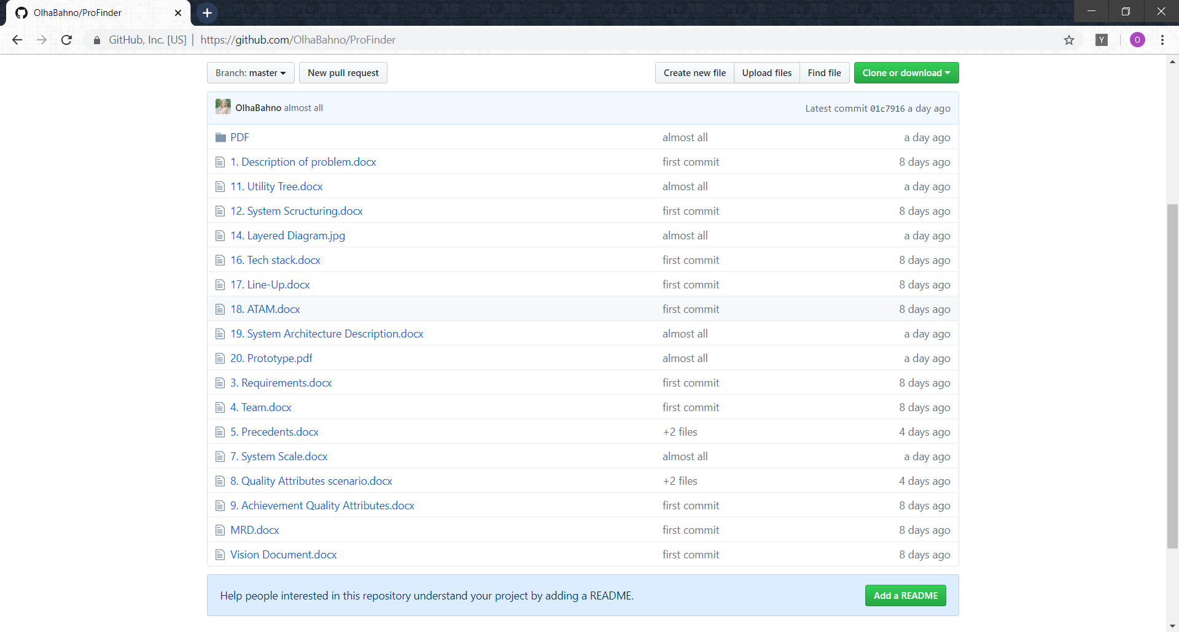

Slide 31
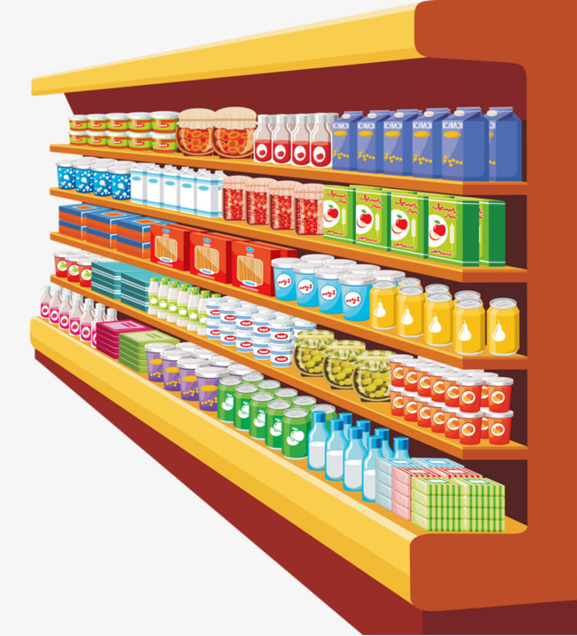

Find us:
Phone: +38(095)828-43-30
E-mail: proFinder@pro-team.com
GitHub: https://github.com/OlhaBahno/ProFinder

